Slide 1

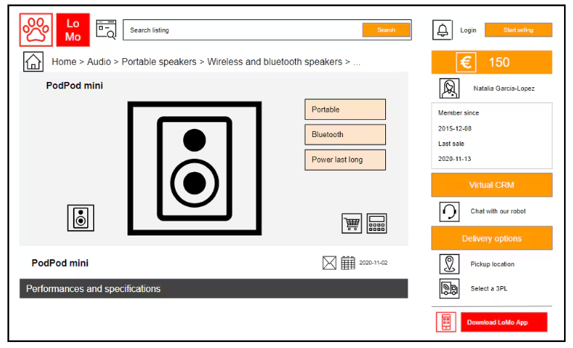

LoMo
Case Challenge

Slide 2

Mostly Cleaned and No Duplicate
11 Datasets = 9 (Operational) + 2 (MQL)
Executive Summary
Master dataset has missing value due to inconsistent order id with the item id. No product information
Mql has ~90% unsuccessful deals
Operational = Master_file.csv
MWL = df_mql_closed.csv
LoMo, an e-commerce platform in Portugal planing to enter Thailand (Asia Pacific) market.
> 95% of the order is delivered
> 70% of the order count is made by Credit Card
They have 3 years of data that covers ~110k orders and ~8k marketing leads between 2016 and 2018.
Data ranging from Q3 2016 to Q3 2018
> 99K cleaned number of records
04
Organic Search lead the source of MQL Closed deal origin
70% of Sellers MQL is a ‘Captain America’

Slide 3



DATA WRANGLING
PROCESS
Cleaning and Feature Engineering
Merging Data
Explore
Dataset
Inspecting and cleaning both datasets. Include steps such as identify null and duplicate value, handling missing value (e.g., dropping irrelevant or nulls, mode imputation, or “Not Available” placeholders). and perform feature engineering
Merging 9 datasets into single master dataset. Merging MQL and Closed Deal Dataset into single smql_closed dataset
Uncover several key features detail about key features inside the datasets

Slide 4

CHALLENGE
ANALYZE PRODUCT CATEGORY PERFORMANCE, REVENUE BY REGION, AND EXAMINE GROWTH
CMO
- Revenue Leaders: Products with the Highest Revenue
- Highest Potential: Measured by MoM / YoY growth
(2016 to 2018)
Identify customer based on
Recency, Frequency, and Monetary
Which product categories perform the best and which shows the highest potential?
Actions
Focus on high Revenue categories for brand-building and cross-selling.
2. Invest in categories with consistent MoM growth.
3. States with the highest revenue foster more targeted campaigns and loyalty programs.
4. Categories with lower current sales but high growth rate can indicate potential, keep brand presence and run localized promotions.
5. High Frequency and Monetary customer segment
to be prioritized.
How should marketing strategy differ across regions (states)?

Slide 5
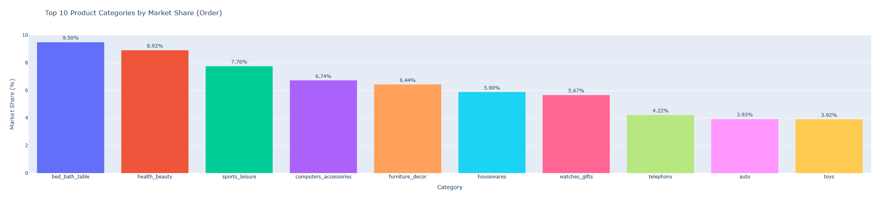
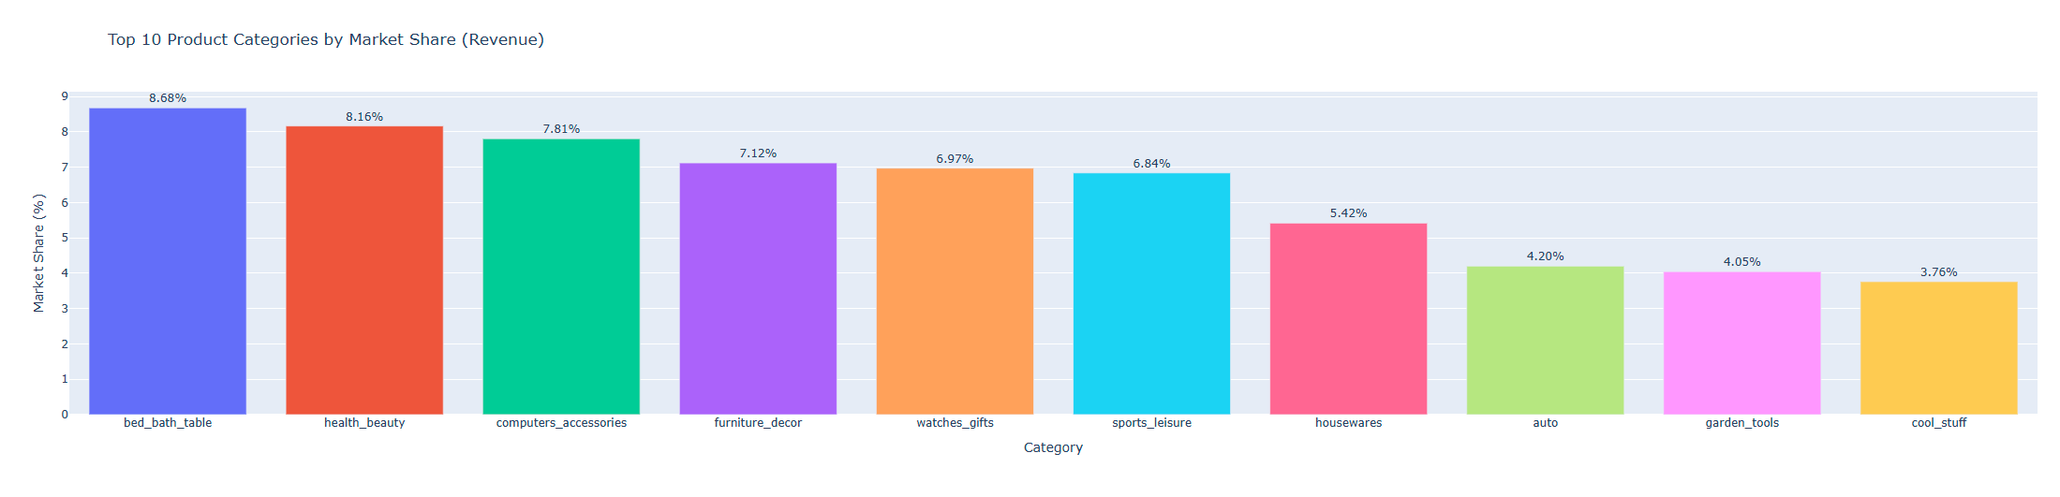
TOP 10 ORDER MARKET SHARE
TOP 10 REVENUE MARKET SHARE

Slide 6
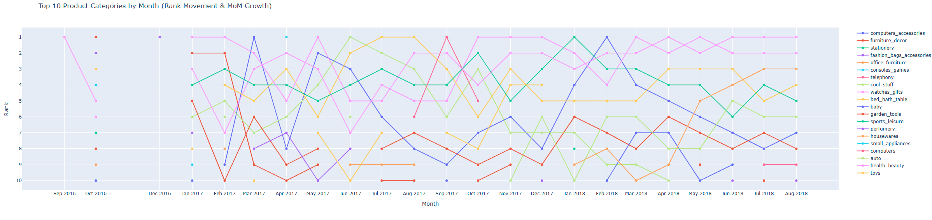
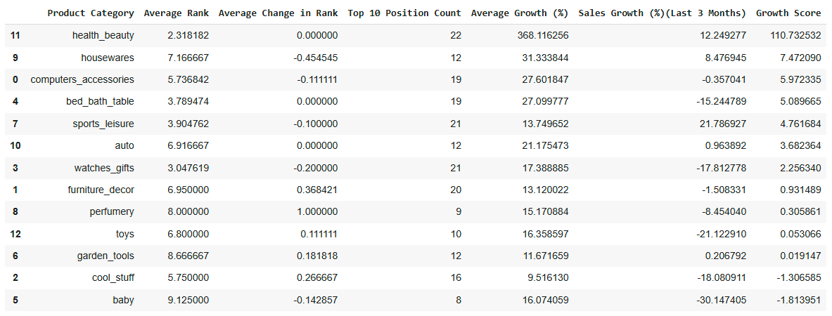
TOP 10 PRODUCT CATEGORIES (MoM + RANK)

Slide 7
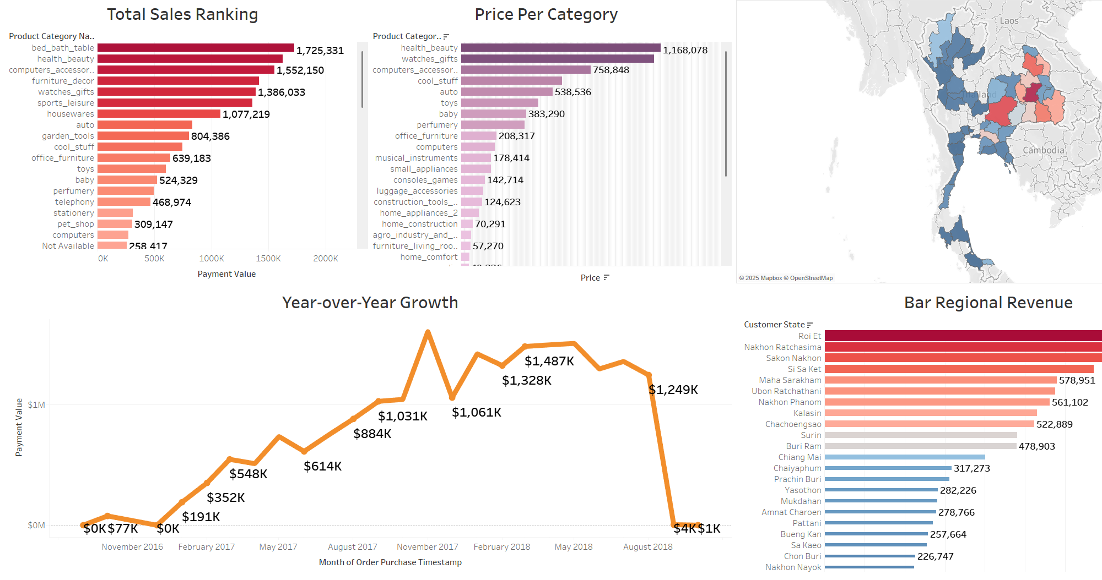

Slide 8
INVESTIGATE DELIVERY TIMES, LATE DELIVERY RATIOS, LEAD CLOSURE RATES BY ORIGIN
COO
- Average Late Delivery Ratio: 13 %
-Average Delivery Time: 12 days
- Lead Closure Origin : Organic Search
How is the trend of delivery performance (on-time vs. late)?
Insights:
1. States with higher late ratios indicate logistic bottlenecks. Enhance the supply chain system and fleet.
2. Lead origins with shorter closure times to be assigned to less experienced SDRs for quick wins.
3. Number of converted leads from top SR /SDR is low. Those SDR/SR should handle the right seller type
How should SDR/SR recruitment strategy adapt to lead types?

Slide 9
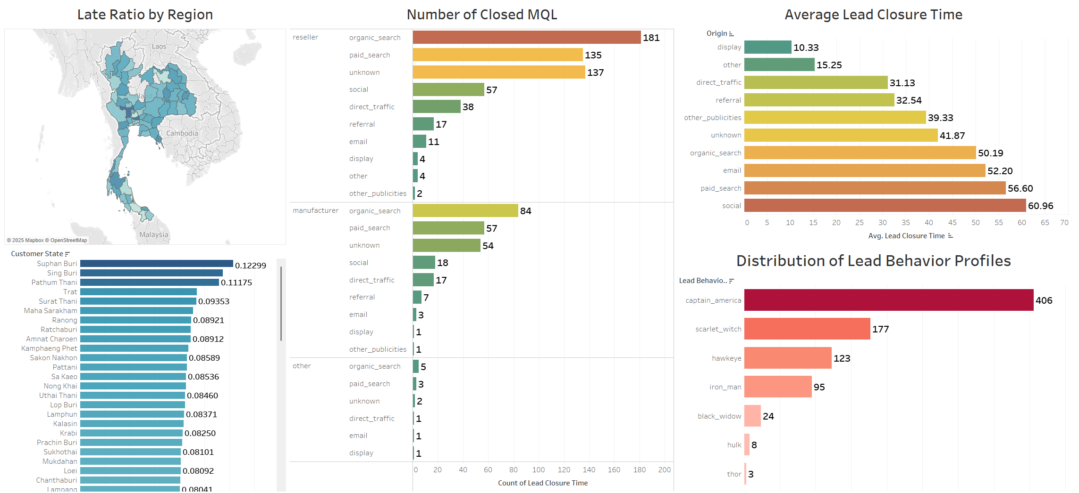

Slide 10



Santasila Bryan Kusno
Data Science and Business Analytics Undergraduate
LinkedIn Profile

